Slide 1
PROJECT ONE · ROUTING · WI-01
Bench setup, frame assembly, motor mounting
STATUS
Complete — 2026-09-20
NEEDS
Everything that has arrived. Not the flight controller.
BATTERY
Stays in the LiPo bag for the entire WI. Not needed, not used.
TIME
~2 h 15 min across five operations
WI-01 · Bench setup, frame assembly, motor mounting
One slide per step · one photo · one check

Slide 2
Deck · WI-01
1
Tools & parts on the bench
7
Motor screw length — do the math
Op 40
2
Prove the iron: heat, hold, tin
Op 10
8
Loctite: dab, dip, drive
Op 40
-
Three practice joints on scrap
Op 10
9
Seat the motor on the arm
Op 40
-
Inventory the open boxes
Op 20
10
Drive the screws in a cross pattern
Op 40
3
Battery storage-voltage check
Op 20
11
Motor check: free spin, wires untrimmed
Op 40
4
Lay out the frame kit
Op 30
12
Stage the ESC and route the wires
Op 50
5
Bottom plate, arms, standoffs
Op 30
13
End state
6
Frame check: flat and square
Op 30
WI-01 · Bench setup, frame assembly, motor mounting
Steps 1-13 of 24

Slide 3
Deck · WI-02
14
Tools & parts on the bench
20
XT60 to the battery pads
Op 20
15
Trim, strip, and tin the motor wires
Op 10
21
Capacitor across the battery pads
Op 20
16
Tin the twelve ESC motor pads
Op 10
22
Shrink everything, no exposed copper
Op 20
17
Solder each motor wire to its pad
Op 10
23
Continuity audit
Op 30
18
Inspect: cone, no bridge, tug test
Op 10
24
End state
19
Heat shrink goes on first
Op 20
WI-02 · ESC soldering: motors, XT60, capacitor
Steps 14-24 of 24

Slide 4
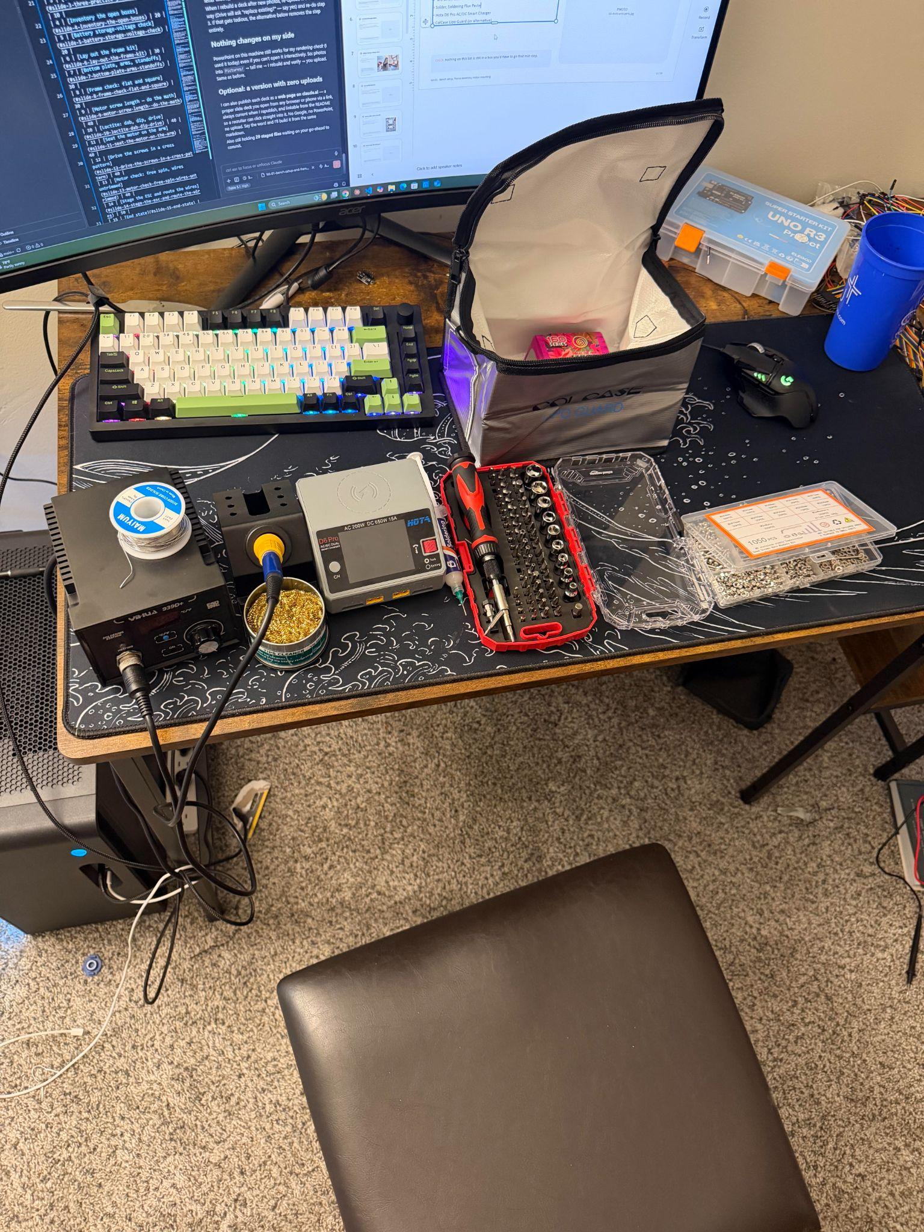

1
Tools & parts on the bench
ON THE BENCH BEFORE STARTING
• Soldering station — YIHUA 939D+ (75 W) with the largest chisel tip
• Hex driver set, multimeter, calipers if you have them
• Safety glasses
• Loctite 243 (blue)
• M3 screw assortment
• Solder, Soldering Flux Paste
• Hota D6 Pro AC/DC Smart Charger
• ColCase Lipo Guard (or alternative)
CHECK nothing on this list is still in a box you'd have to go find mid-step.
WI-01 · Bench setup, frame assembly, motor mounting
1 / 24

Slide 5
2
Prove the iron: heat, hold, tin
OP 10 · 5 MIN
The AiXun sat in its box, turned out to be defective, and cost a week. The first thing the new iron does is prove it works.
PHOTO
02-iron-at-temperature.jpg
DO
1. Power on the YIHUA. Set 350 °C / 662 °F.
2. Fit the largest chisel tip.
3. Tin it — touch solder to the hot tip.
CHECK display reaches and holds temperature. Solder flows and coats the tip instantly; if it balls up, the tip isn't hot or isn't clean.
WI-01 · Bench setup, frame assembly, motor mounting
2 / 24

Slide 6
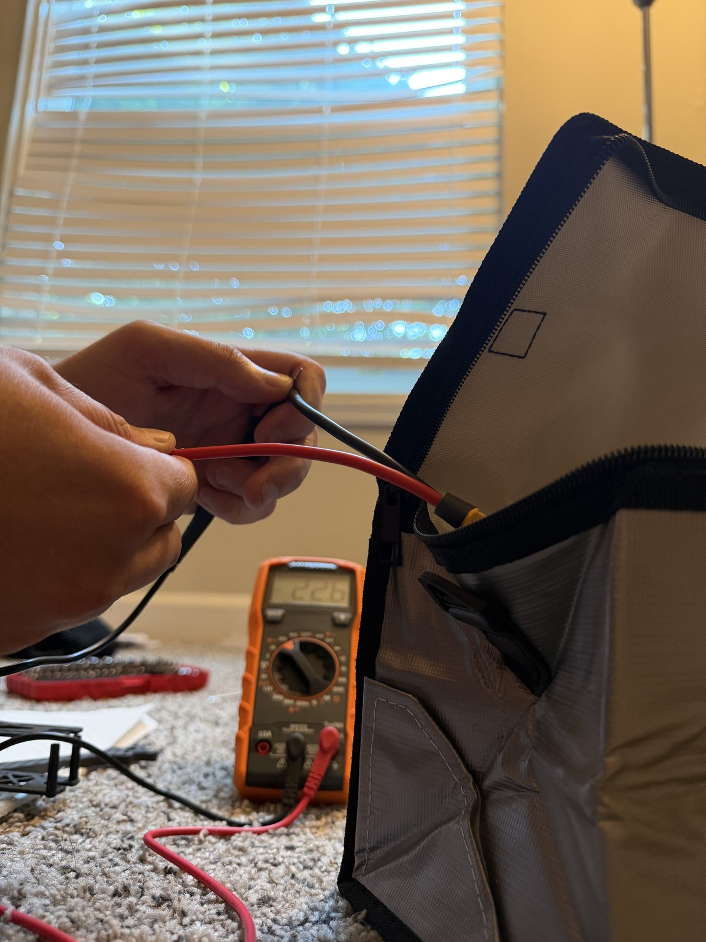
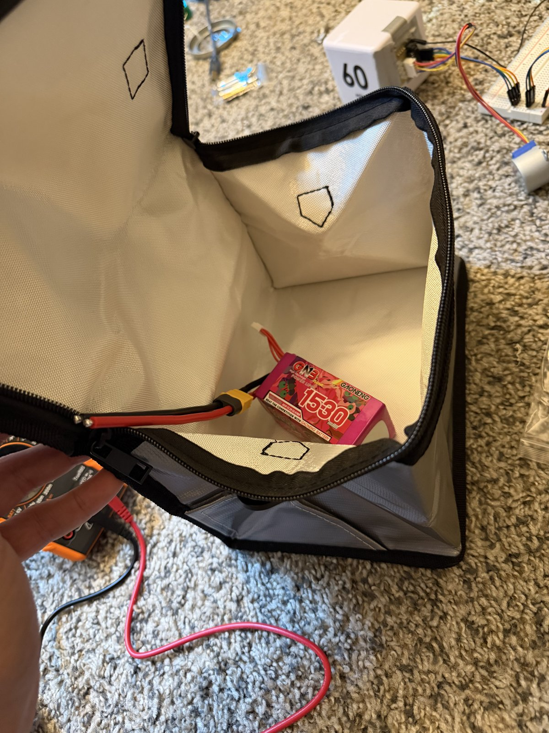
3
Battery storage-voltage check
OP 20 · 5 MIN
TOOLS ⚡ Multimeter · Safety glasses
PARTS ⚡ 6S LiPo pack (XT60) · LiPo bag
DO
1. Multimeter on DC volts.
2. Measure pack voltage at the XT60 — red probe to the + pin, black to −.
3. Straight back into the LiPo bag.
CHECK ~22.2–22.8 V for a 6S pack at storage charge (3.7–3.8 V per cell). Anything far outside that range is a question for the charger, not the bench.
WI-01 · Bench setup, frame assembly, motor mounting
3 / 24

Slide 7
4
Lay out the frame kit
OP 30 · 10 MIN
TOOLS Kit sheet
PARTS Source One V6 plates · arms · standoffs · M3×10/12/14 hardware
DO
1. Lay out every Source One V6 plate, arm, standoff, and bag of hardware against the kit sheet.
2. Sort the hardware by length. The kit's M3×10 / 12 / 14 screws are standoff hardware — they are not motor screws.
PHOTO
06-frame-kit-layout.jpg
CHECK everything on the kit sheet is present and sorted before a single screw is driven.
WI-01 · Bench setup, frame assembly, motor mounting
4 / 24

Slide 8
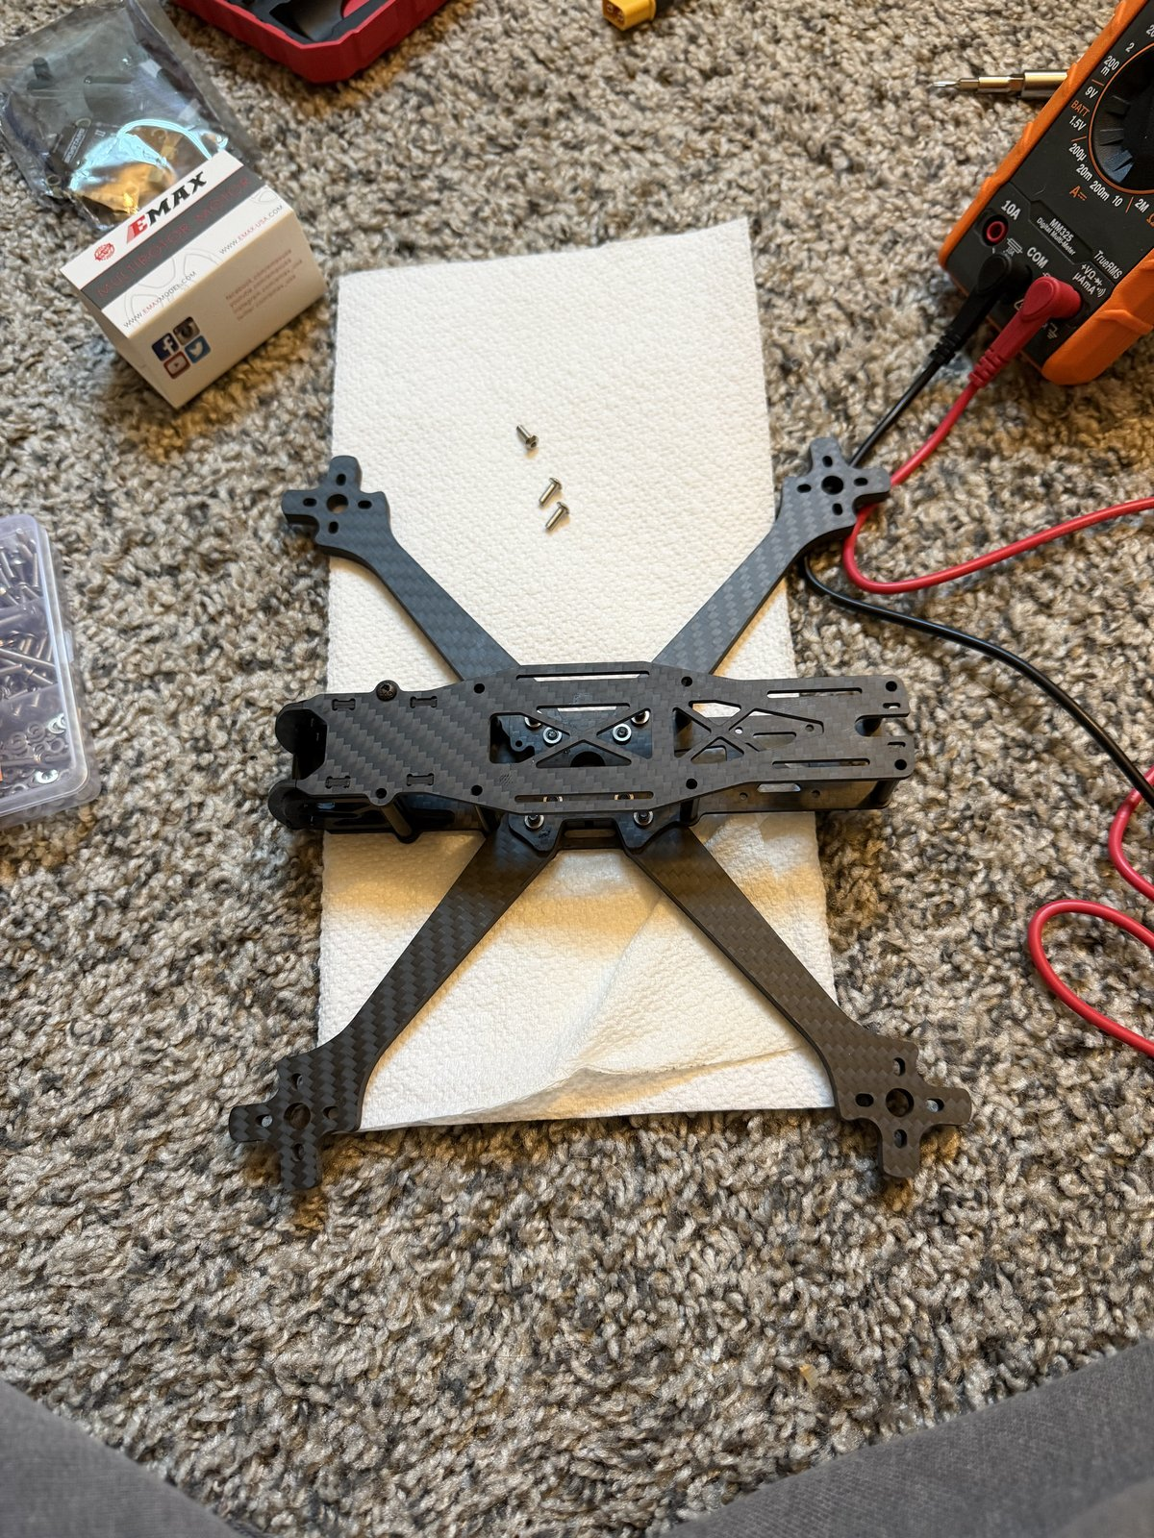
5
Bottom plate, arms, standoffs
OP 30 · 30 MIN
TOOLS Hex driver set · Loctite 243 (blue)
PARTS Bottom plate · 4 arms · standoffs · frame bolts
DO
1. Bottom plate first, then the four arms, then the standoffs.
2. One drop of blue Loctite on each frame bolt.
3. Snug, not gorilla-tight. Carbon fibre crushes under an over-torqued bolt and there is no undoing it.
CHECK every frame bolt has Loctite and is snug; no bolt bottomed out.
WI-01 · Bench setup, frame assembly, motor mounting
5 / 24

Slide 9
6
Frame check: flat and square
OP 30 · 5 MIN
TOOLS Flat reference surface
PARTS Assembled frame
DO
1. Set the assembled frame on a flat surface and press each arm tip.
2. Sight down the stack holes.
PHOTO
08-frame-flat-check.jpg
CHECK no rock on any arm. Stack holes line up on the 30 × 30 mm pattern — the FC and ESC both mount to it.
WI-01 · Bench setup, frame assembly, motor mounting
6 / 24

Slide 10
7
Motor screw length — do the math
OP 40 · 10 MIN
TOOLS Calipers · ⚡ multimeter (case as gauge)
PARTS M3 screw assortment · arm · ⚡ motor
PHOTO
09-screw-length-measure.jpg
CAUTION Wrong screw length is the #1 motor killer. A screw that reaches the windings shorts the motor the first time it spins. Make SURE screw does not touch motor
DO
1. Measure arm thickness — calipers, or the edge of the multimeter case (~6 mm).
2. Measure the motor's blind-hole depth.
3. Target thread into the motor = arm + ~5 mm. Pick screws from the assortment to match.
CHECK test-fit a screw through the arm into a motor by hand — the tip sits at least 1 mm short of the hole bottom.
WI-01 · Bench setup, frame assembly, motor mounting
7 / 24

Slide 11
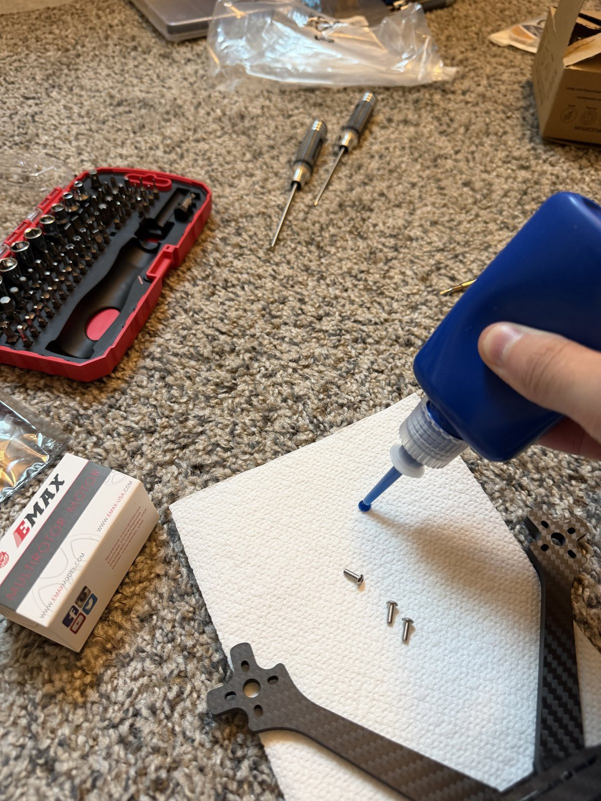
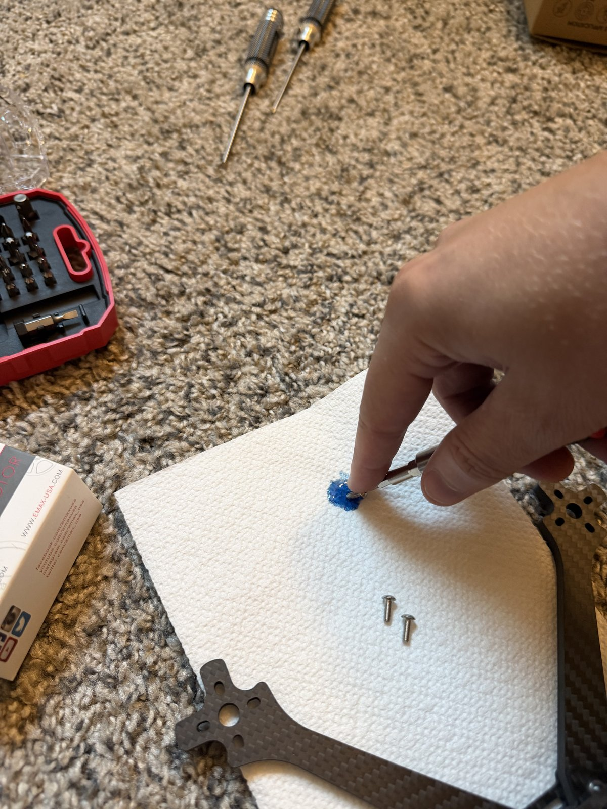
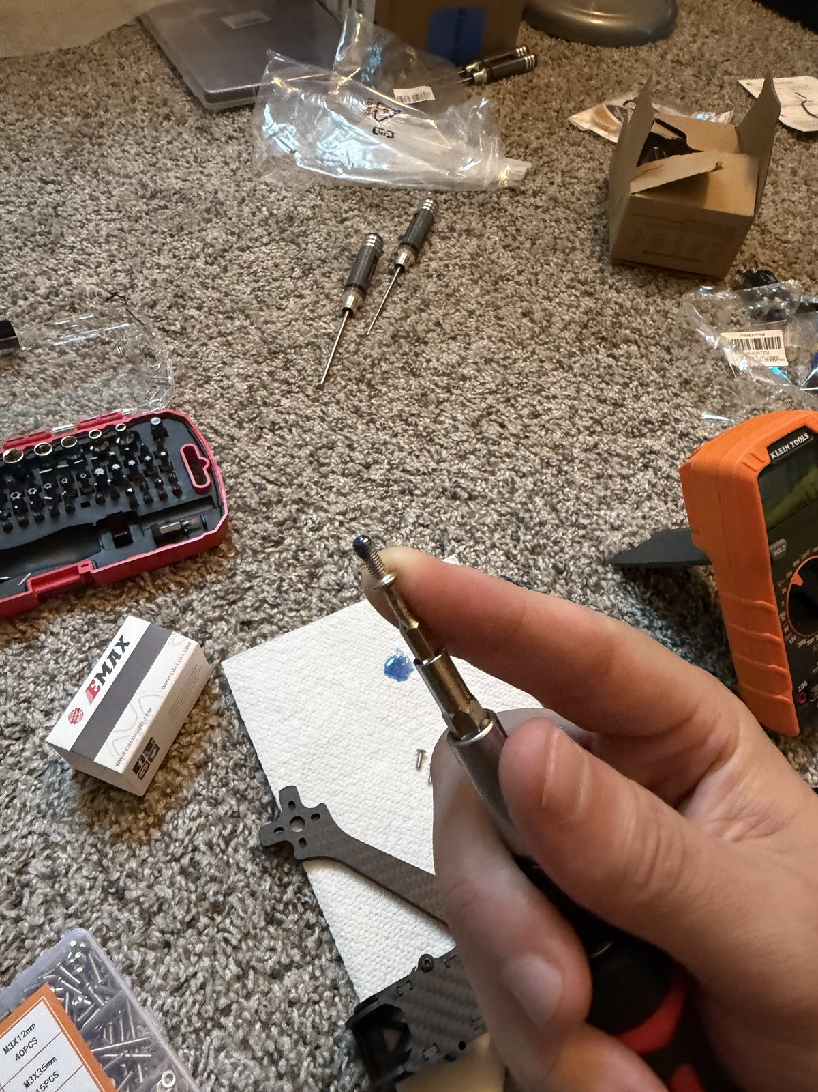
8
Loctite: dab, dip, drive
OP 40 · 5 MIN
TOOLS Loctite 243 (blue) · paper towel · hex driver
PARTS M3 motor screws
The bottle nozzle puts far too much on a screw this small. Dab, then dip.
DO
1. Squeeze one drop of blue Loctite 243 onto a paper towel.
2. Touch each screw's threads into the drop — a thin film, not a coating.
3. Drive it within a minute or two, before it starts to set.
CHECK blue on the threads only, none on the screw head or the carbon.
WI-01 · Bench setup, frame assembly, motor mounting
8 / 24

Slide 12
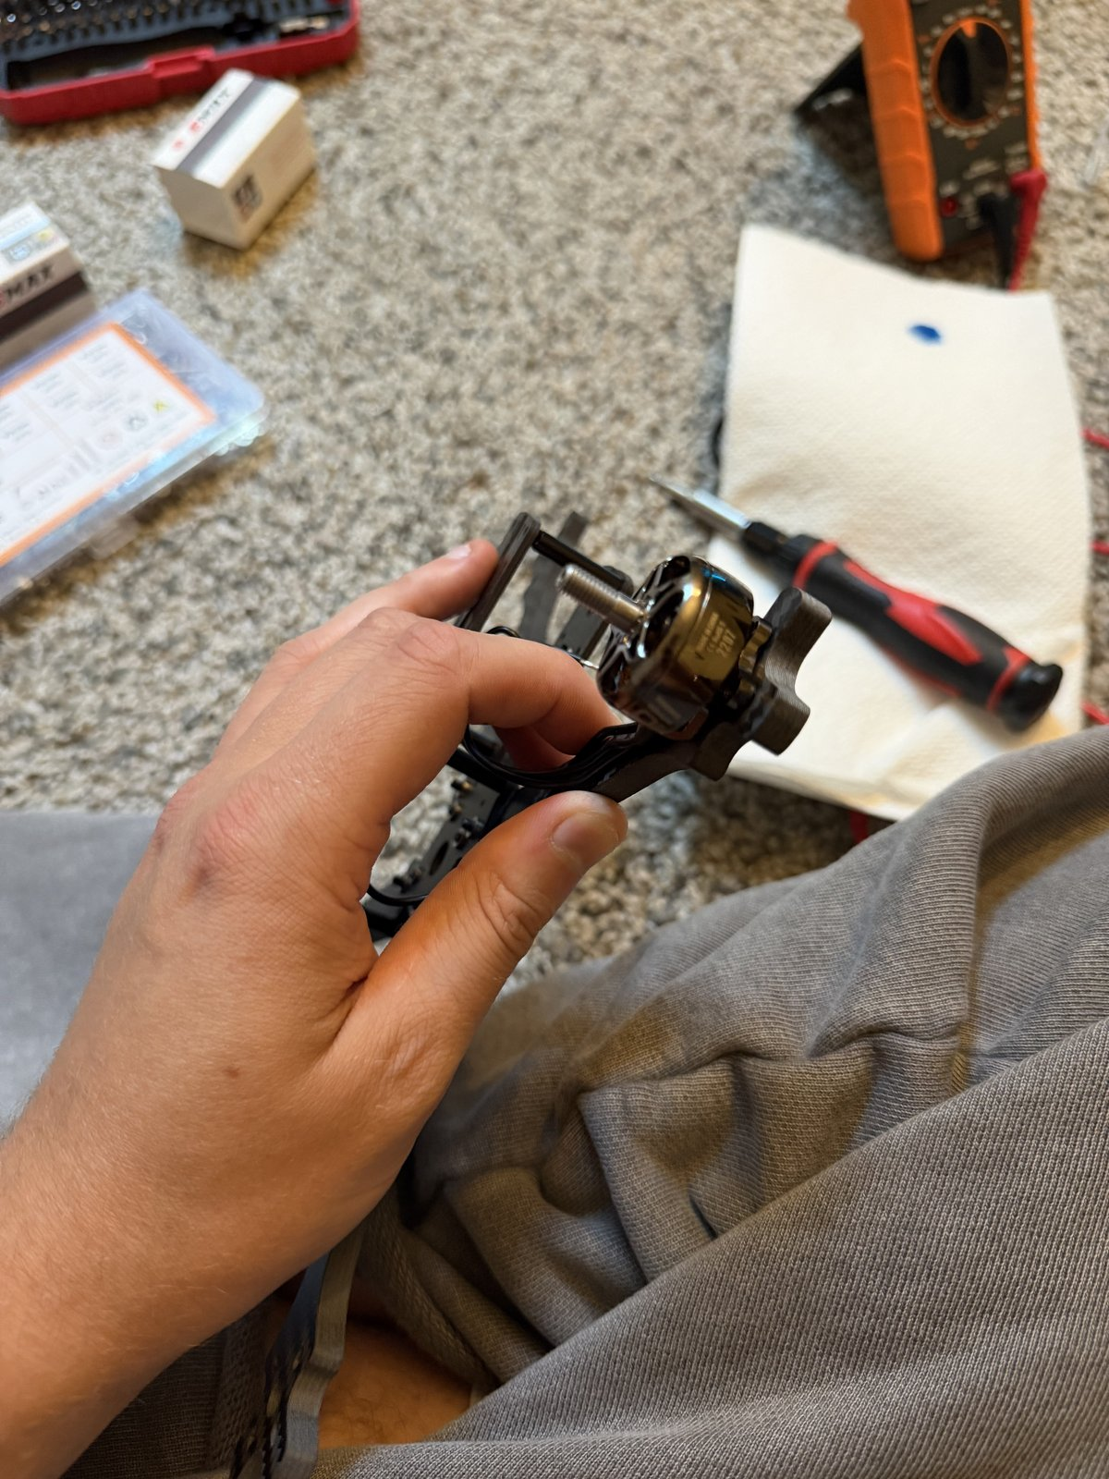
9
Seat the motor on the arm
OP 40 · 10 MIN
TOOLS Safety glasses · hex driver
PARTS ⚡ Motor · arm
SAFETY GLASSES ON.
DO
1. Set the motor on the arm end, bolt holes aligned with the arm's 16 × 16 mm pattern.
2. Wires pointing inboard, toward the centre of the frame.
3. Hold it flat while the first screw goes in.
CHECK motor base sits flush on the arm, all four holes visible through the arm, wires headed toward the stack.
WI-01 · Bench setup, frame assembly, motor mounting
9 / 24

Slide 13
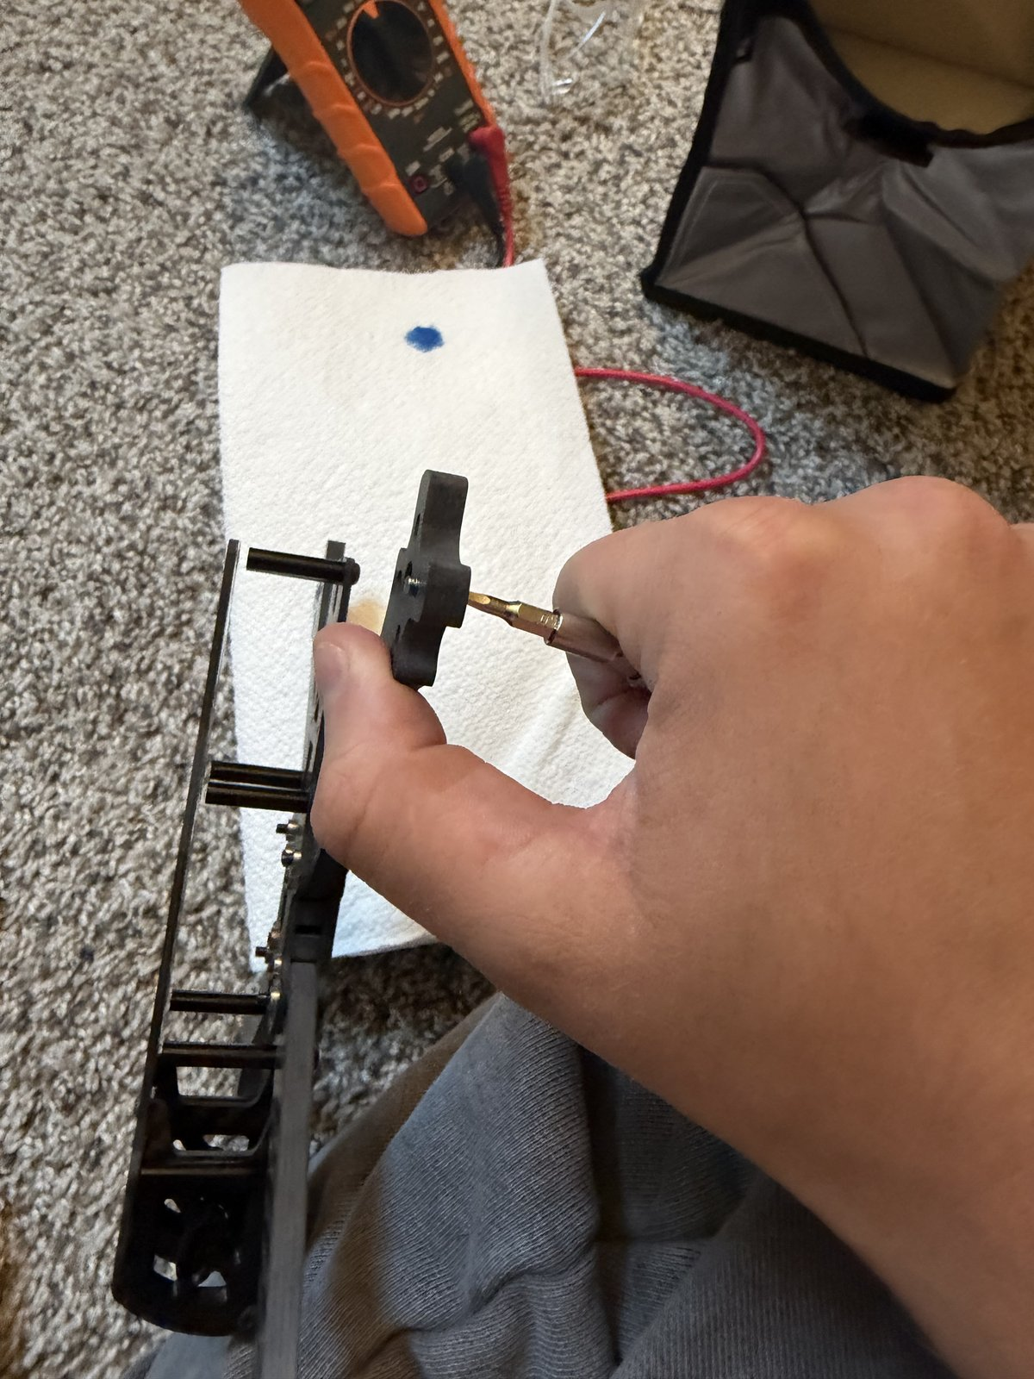
10
Drive the screws in a cross pattern
OP 40 · 20 MIN
TOOLS Hex driver
PARTS 16 × M3 motor screws · ⚡ 4 motors · frame
DO
1. Screws go up through the arm, into the motor — from underneath.
2. Drive them in a cross pattern — one corner, then the opposite corner, then the other pair — so the motor seats flat, not tilted.
3. Snug only. Same rule as the frame bolts.
4. Repeat for all four motors.
CHECK all 16 screws in, all Loctited, no gap between motor base and arm on any motor.
WI-01 · Bench setup, frame assembly, motor mounting
10 / 24

Slide 14
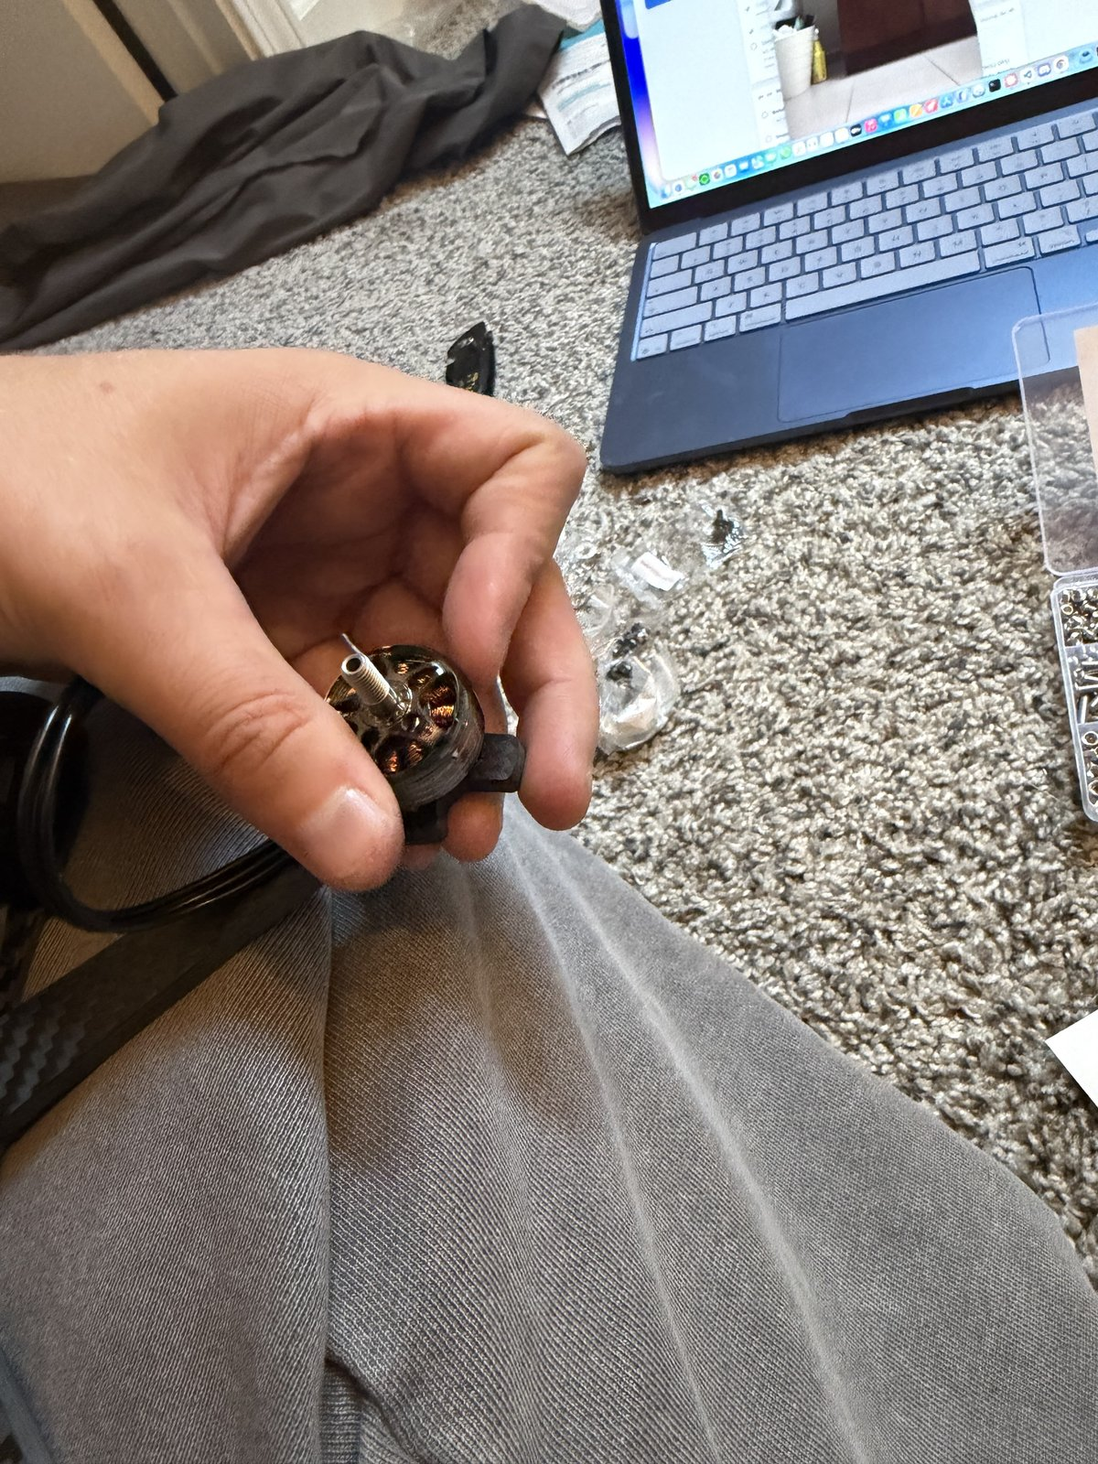
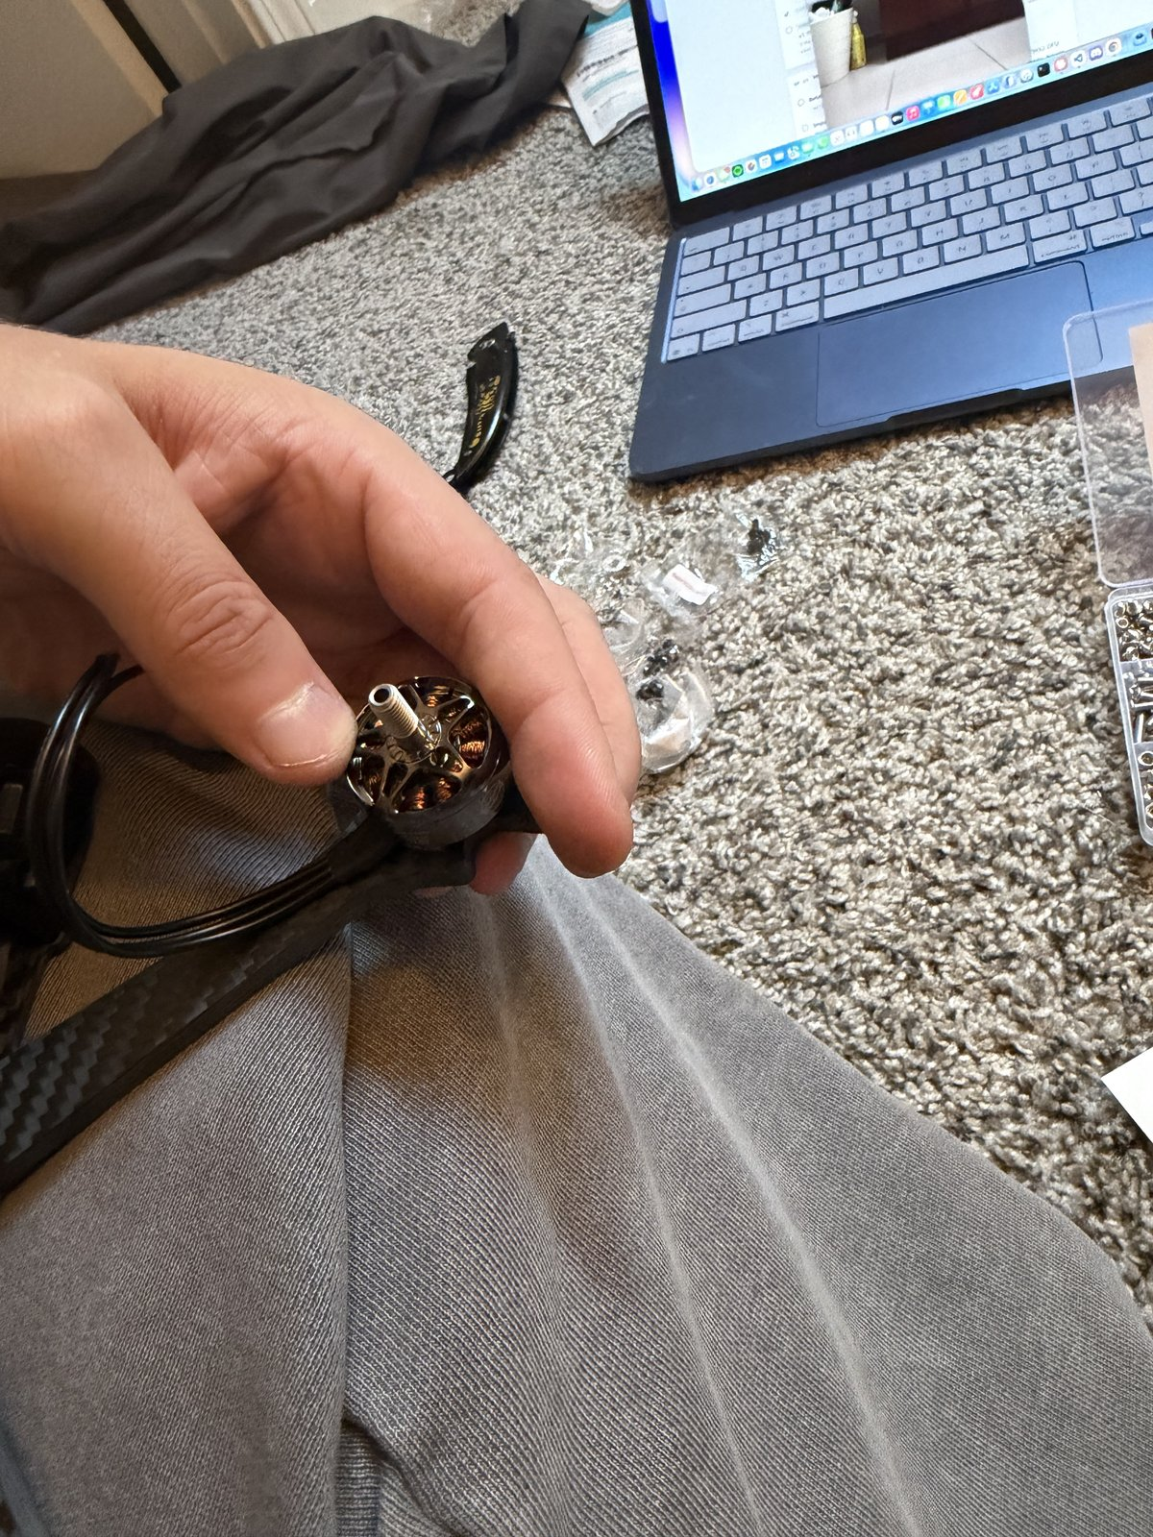
11
Motor check: free spin, wires untrimmed
OP 40 · 5 MIN
TOOLS Hands only — no tools
PARTS ⚡ 4 mounted motors
DO
1. Spin each motor bell by hand — both directions.
2. Leave every motor wire at full length.
CHECK each motor spins freely both ways — no scraping, no wobble, no tick. A tick means a screw is touching the windings: back it out now. Do not trim motor wires yet; final length depends on where the ESC sits.
WI-01 · Bench setup, frame assembly, motor mounting
11 / 24

Slide 15
PROJECT ONE · ROUTING · WI-02
ESC soldering: motors, XT60, capacitor
STATUS
In progress — started 2026-09-21
NEEDS
WI-01 complete. Not the flight controller — it connects to the ESC by a plug-in cable, so none of these joints wait on it.
BATTERY
None in this WI. First power-up is WI-03, through the smoke stopper, after the pinout check.
TIME
~2 h 30 min across three operations — 14 joints total
WI-02 · ESC soldering: motors, XT60, capacitor
One slide per step · one photo · one check

Slide 16
14
Tools & parts on the bench
ON THE BENCH BEFORE STARTING
PHOTO
01-tools-and-parts.jpg
• Iron with the largest chisel tip
• Solder (63/37), flux, wick
• Side cutters, wire strippers
• Heat shrink — sized for the motor wires and for the XT60 leads
• Helping-hands station with magnifier (from Day 3 on)
• ESC — Skystars KO60II
• XT60 pigtail (or the one from the ESC box)
• Capacitor — read the can: 1000 µF 35 V. The stripe side is negative. A 25 V cap blows on 6S.
• Safety glasses
CHECK the battery is in its bag, somewhere else. It does not come to the bench today.
WI-02 · ESC soldering: motors, XT60, capacitor
14 / 24

Slide 17
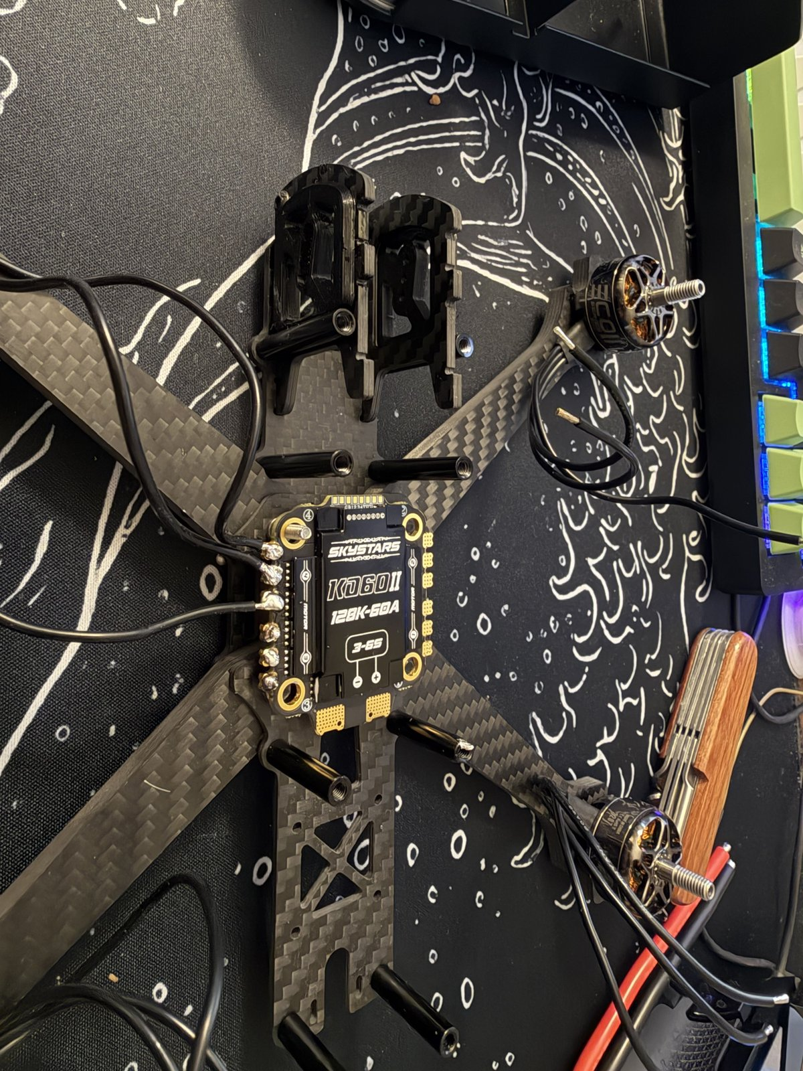
15
Trim, strip, and tin the motor wires
OP 10 · 20 MIN
TOOLS ⚡ Soldering station · flush cutters · wire strippers · flux
PARTS ⚡ 12 motor wires · solder
DO — FOR ALL TWELVE MOTOR WIRES:
1. Dry-fit the ESC on the standoffs, pads to the rear. Route each motor's wires to its corner; cut with a little slack.
2. Strip ~2 mm of insulation.
3. Flux the bare end and tin it — iron under, solder on top, until the strands wick full.
CHECK each tinned end is a smooth silver cylinder, not a blob, and no stray strands stick out.
WI-02 · ESC soldering: motors, XT60, capacitor
15 / 24

Slide 18
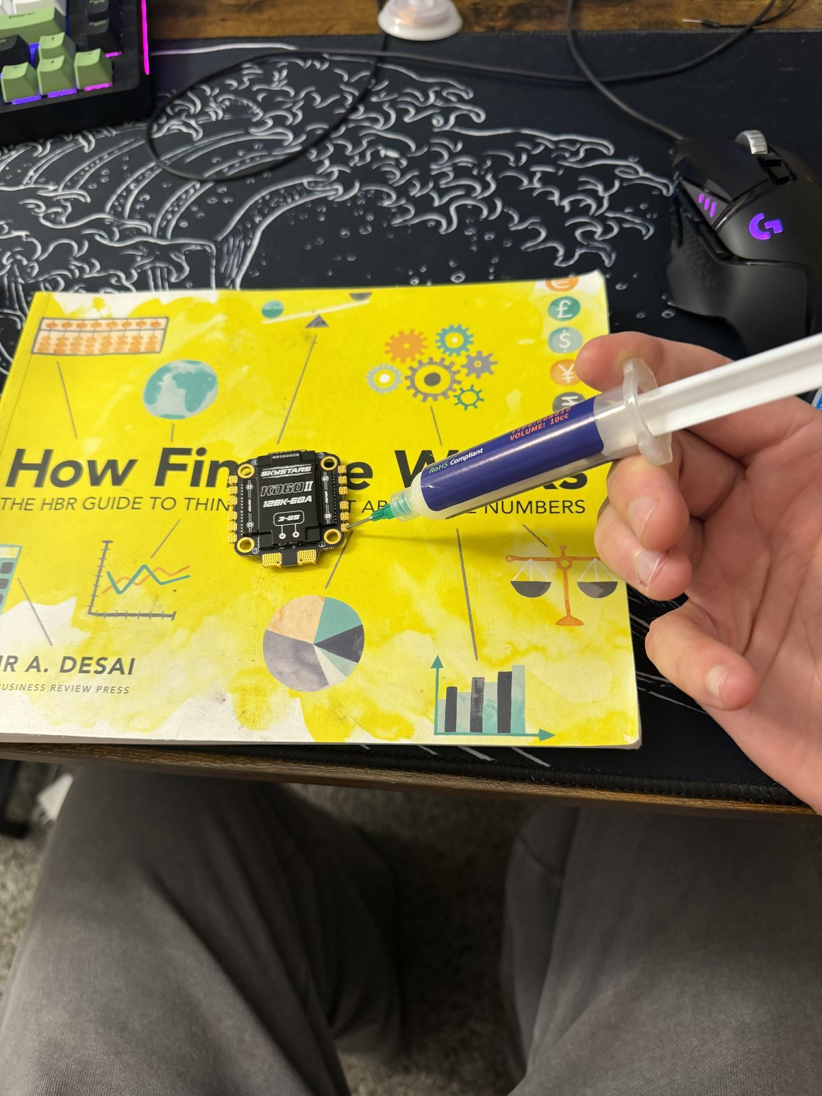
16
Tin the twelve ESC motor pads
OP 10 · 15 MIN
TOOLS ⚡ Soldering station (chisel tip) · flux pen
PARTS ⚡ ESC motor pads · solder
DO
1. Flux every motor pad.
2. Iron at 350–370 °C.
3. Put a small blob of solder on each pad — the pad should wet and the blob should sit domed, not spread.
CHECK twelve shiny domes, none touching a neighbor.
WI-02 · ESC soldering: motors, XT60, capacitor
16 / 24

Slide 19
17
Solder each motor wire to its pad
OP 10 · 45 MIN
TOOLS ⚡ Soldering station · tweezers
PARTS ⚡ 12 tinned motor wires · ⚡ ESC motor pads · solder
DO — ONE JOINT AT A TIME, TWELVE TIMES:
1. Lay the tinned wire on its pad.
2. Iron on pad and wire together.
3. Feed a little solder into the joint.
4. Hold still for 2 seconds after the iron lifts — moving a cooling joint makes a cold one.
PHOTO
04-solder-motor-wire.jpg
Wire order within a corner doesn't matter — motor direction is fixed in software later.
CHECK the wire doesn't move when nudged, and the solder flowed onto both pad and wire.
WI-02 · ESC soldering: motors, XT60, capacitor
17 / 24

Slide 20
18
Inspect: cone, no bridge, tug test
OP 10 · 10 MIN
TOOLS Magnifier · bright light · tweezers
PARTS ⚡ 12 solder joints
DO — UNDER THE MAGNIFIER, EVERY JOINT:
1. Look for a shiny cone climbing from pad to wire.
2. Look between neighbors for any bridge.
3. Tug each wire, gently.
PHOTO
05-inspect-joints.jpg
CHECK twelve shiny cones, no dull balls, no bridges, no movement. Any joint that fails gets wicked and redone — not reheated and hoped for.
WI-02 · ESC soldering: motors, XT60, capacitor
18 / 24

Slide 21
19
Heat shrink goes on first
OP 20 · 2 MIN
TOOLS Flush cutters · ruler
PARTS Heat shrink tubing · ⚡ XT60 leads
DO
1. Cut a length of heat shrink for each XT60 lead.
2. Slide both pieces onto the leads now, pushed well back from the ends.
PHOTO
06-heat-shrink-on-leads.jpg
CHECK two pieces of shrink on the leads before the iron gets near them. It cannot go on after the joint is made.
WI-02 · ESC soldering: motors, XT60, capacitor
19 / 24

Slide 22
20
XT60 to the battery pads
OP 20 · 25 MIN
TOOLS ⚡ Soldering station (480 °C, largest tip) · flux
PARTS ⚡ XT60 pigtail · ⚡ ESC battery pads · solder
CAUTION These are the two big joints. Max temperature (480 °C), largest tip, patience. Let the pad fully wet before feeding solder — 75 W needs a few extra seconds, not force.
DO
1. Tin the two big pads generously.
2. Red → +, black → −. Triple-check before the iron touches. Reversed polarity destroys the ESC instantly.
3. Tinned lead on tinned pad, iron on both, feed solder until it flows through, hold still to cool.
PHOTO
07-xt60-battery-pads.jpg
CHECK both leads solid, polarity confirmed against the ESC silkscreen a fourth time.
WI-02 · ESC soldering: motors, XT60, capacitor
20 / 24

Slide 23
21
Capacitor across the battery pads
OP 20 · 15 MIN
TOOLS ⚡ Soldering station · flush cutters
PARTS ⚡ 1000 µF 35 V capacitor · ⚡ ESC battery pads · solder
DO
1. Trim the capacitor legs short — it sits close to the board.
2. Stripe to −. The stripe on the can marks the negative leg.
3. Solder each leg to the same battery pads as the XT60.
PHOTO
08-capacitor.jpg
CHECK 1000 µF 35 V, stripe on the − pad, legs not touching anything else.
WI-02 · ESC soldering: motors, XT60, capacitor
21 / 24

Slide 24
22
Shrink everything, no exposed copper
OP 20 · 5 MIN
TOOLS ⚡ Soldering iron barrel (or lighter)
PARTS Heat shrink tubing · ⚡ XT60 joints
DO
1. Slide the shrink from slide 6 down over the XT60 joints.
2. Shrink it — iron barrel held near, rotate; or the lower half of a lighter flame, kept moving.
PHOTO
09-shrink-done.jpg
CHECK no exposed copper anywhere on the battery side of the ESC.
WI-02 · ESC soldering: motors, XT60, capacitor
22 / 24

Slide 25
23
Continuity audit
OP 30 · 20 MIN
TOOLS ⚡ Multimeter (continuity mode)
PARTS ⚡ Soldered ESC · ⚡ XT60 leads
CAUTION Multimeter on continuity. No battery anywhere near the bench.
DO
1. XT60 + to −.
2. Each motor wire to its own pad, then to each neighbor pad.
3. + pad to every motor pad and to the frame; − pad likewise.
PHOTO
10-continuity-audit.jpg
CHECK
✓ + to − reads OPEN. A brief blip while the capacitor charges is fine; a solid beep is a short — stop and find it.
✓ Every motor wire beeps to its own pad only.
✓ Neither battery pad beeps to any motor pad or to the frame (intended grounds excepted).
WI-02 · ESC soldering: motors, XT60, capacitor
23 / 24

Slide 26
24
End state
WI-02 IS DONE WHEN ALL OF THESE ARE TRUE:
• Twelve motor joints soldered, inspected, tug-tested
• XT60 on the battery pads, polarity confirmed, shrink over both joints
• 1000 µF 35 V capacitor across the pads, stripe to −
• Continuity audit passed — no shorts, no crossed pads
• The powertrain has still never been powered.
PHOTO
11-end-state.jpg
NEXT WI-03 — FC install, pinout check, first power through the smoke stopper. Unblocks when the SkyStars H743 lands.
TOOLS ⚡ Soldering station · flux · tweezers · flush cutters · ⚡ multimeter
PARTS ⚡ ESC · ⚡ 12 motor wires · ⚡ XT60 pigtail · ⚡ 1000 µF capacitor · heat shrink · solder
WI-02 · ESC soldering: motors, XT60, capacitor
24 / 24

